Slide 1
Emerging Technologies for the Circular Economy
Lecture 2: Circular Economy I
Prof. Dr. Benjamin Leiding (Clausthal)
M.Sc. Arne Bochem (Göttingen)
M.Sc. Anant Sujatanagarjuna (Clausthal)
Notes:
<number>

Slide 2
License
This work is licensed under a Creative Commons Attribution-ShareAlike 4.0 International License. To view a copy of this license, please refer to https://creativecommons.org/licenses/by-sa/4.0/ .
Updated versions of these slides will be available in our Github repository.

Slide 3
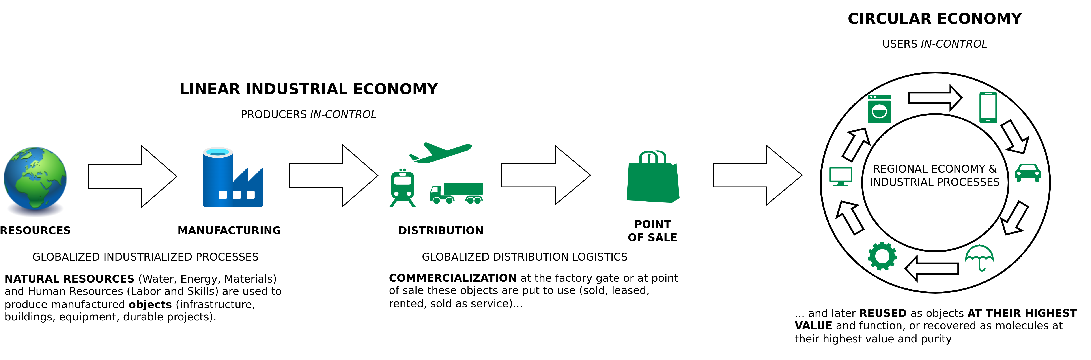
The Linear (Industrial) Economy
Image adapted from: Walter R. Stahel (2019) – The Circular Economy: A User’s Guide.

Slide 4
The Circular Economy

Slide 5
Circular Economy
Image adapted from https://www.ellenmacarthurfoundation.org/circular-economy/concept/infographic

Slide 6
Circular Economy
Center for Digital Technologies (DIGIT) (2022) – https://www.digit-research.de/fileadmin/DIGIT/Presse_und_News/Downloads/Grafikpaket_Reallabor_DCE_Kreislaufmodell_V2_ccby.zip – CC BY 4.0.

Slide 7
Circular Economy – Definitions
“Conceptualizing the circular economy: An analysis of 114 definitions.”
Kirchherr, Julian, Denise Reike and Marko P. Hekkert. Resources Conservation and Recycling 127 (2017): 221-232.
https://doi.org/10.1016/J.RESCONREC.2017.09.005
Kirchherr, J., Reike, D., & Hekkert, M. (2017) – Conceptualizing the circular economy: An analysis of 114 definitions. Resources, conservation and recycling, 127, 221-232.

Slide 8
Circular Economy – Definitions
“A circular economy is an industrial system that is restorative or regenerative by intention and design. It replaces the ‘end-of-life’ concept with restoration, shifts towards the use of renewable energy, eliminates the use of toxic chemicals, which impair reuse, and aims for the elimination of waste through the superior design of materials, products, systems, and, within this, business models.”
– Ellen MacArthur Foundation
https://www.ellenmacarthurfoundation.org/assets/downloads/publications/Ellen-MacArthur-Foundation-Towards-the-Circular-Economy-vol.1.pdf

Slide 9
Circular Economy – Definitions
“A circular economy is an industrial system that is restorative or regenerative by intention and design. It replaces the ‘end-of-life’ concept with restoration, shifts towards the use of renewable energy, eliminates the use of toxic chemicals, which impair reuse, and aims for the elimination of waste through the superior design of materials, products, systems, and, within this, business models.”
– Ellen MacArthur Foundation
“The circular economy is a model of production and consumption, which involves sharing, leasing, reusing, repairing, refurbishing and recycling existing materials and products as long as possible. In this way, the life cycle of products is extended.”
– European Parliament
https://www.ellenmacarthurfoundation.org/assets/downloads/publications/Ellen-MacArthur-Foundation-Towards-the-Circular-Economy-vol.1.pdf
https://www.europarl.europa.eu/news/en/headlines/economy/20151201STO05603/circular-economy-definition-importance-and-benefts
Notes:
<number>

Slide 10
Circular Industrial Economy – Definitions
“The circular industrial economy manages stocks of manufactured assets, such as infrastructure, buildings, vehicles, equipment and consumer goods, to maintain their value and utility as high as possible for as long as possible; and stocks of resources at their highest purity and value.”
Walter R. Stahel (2019) – The Circular Economy: A User’s Guide.

Slide 11
Sustainability – Definition
„Development that meets the needs of the present without compromising the ability of future generations to meet their own needs.”
Report of the World Commission on Environment and Development: Our Common Future (1987) – http://www.un-documents.net/our-common-future.pdf

Slide 12
Sustainability – Definition
Social
Economic
Environment
Based on: Thomsen C. (2013) Sustainability (World Commission on Environment and Development Definition). In: Idowu S.O., Capaldi N., Zu L., Gupta A.D. (eds) Encyclopedia of Corporate Social Responsibility. Springer, Berlin, Heidelberg. https://doi.org/10.1007/978-3-642-28036-8_531

Slide 13
Sustainability – Definition
Social
Viable
Economic
Environment
Based on: Thomsen C. (2013) Sustainability (World Commission on Environment and Development Definition). In: Idowu S.O., Capaldi N., Zu L., Gupta A.D. (eds) Encyclopedia of Corporate Social Responsibility. Springer, Berlin, Heidelberg. https://doi.org/10.1007/978-3-642-28036-8_531

Slide 14
Sustainability – Definition
Social
Bearable
Equitable
Viable
Economic
Environment
Based on: Thomsen C. (2013) Sustainability (World Commission on Environment and Development Definition). In: Idowu S.O., Capaldi N., Zu L., Gupta A.D. (eds) Encyclopedia of Corporate Social Responsibility. Springer, Berlin, Heidelberg. https://doi.org/10.1007/978-3-642-28036-8_531

Slide 15
Sustainable
Sustainability – Definition
Social
Bearable
Equitable
Viable
Economic
Environment
Based on: Thomsen C. (2013) Sustainability (World Commission on Environment and Development Definition). In: Idowu S.O., Capaldi N., Zu L., Gupta A.D. (eds) Encyclopedia of Corporate Social Responsibility. Springer, Berlin, Heidelberg. https://doi.org/10.1007/978-3-642-28036-8_531

Slide 16
Sustainability – Implications
Sustainability → Consume less
Report of the World Commission on Environment and Development: Our Common Future (1987) – http://www.un-documents.net/our-common-future.pdf

Slide 17
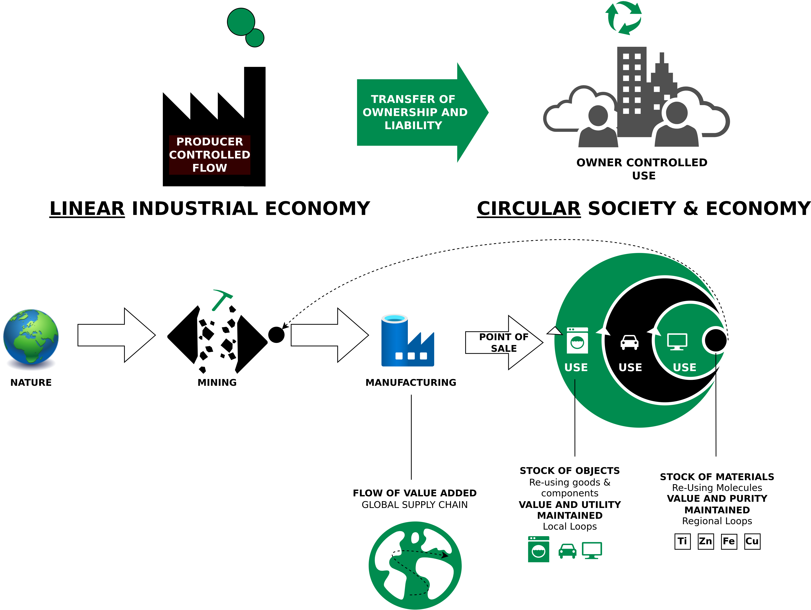
Circular Economy – Characteristics
Image adapted from: Walter R. Stahel (2019) – The Circular Economy: A User’s Guide.

Slide 18
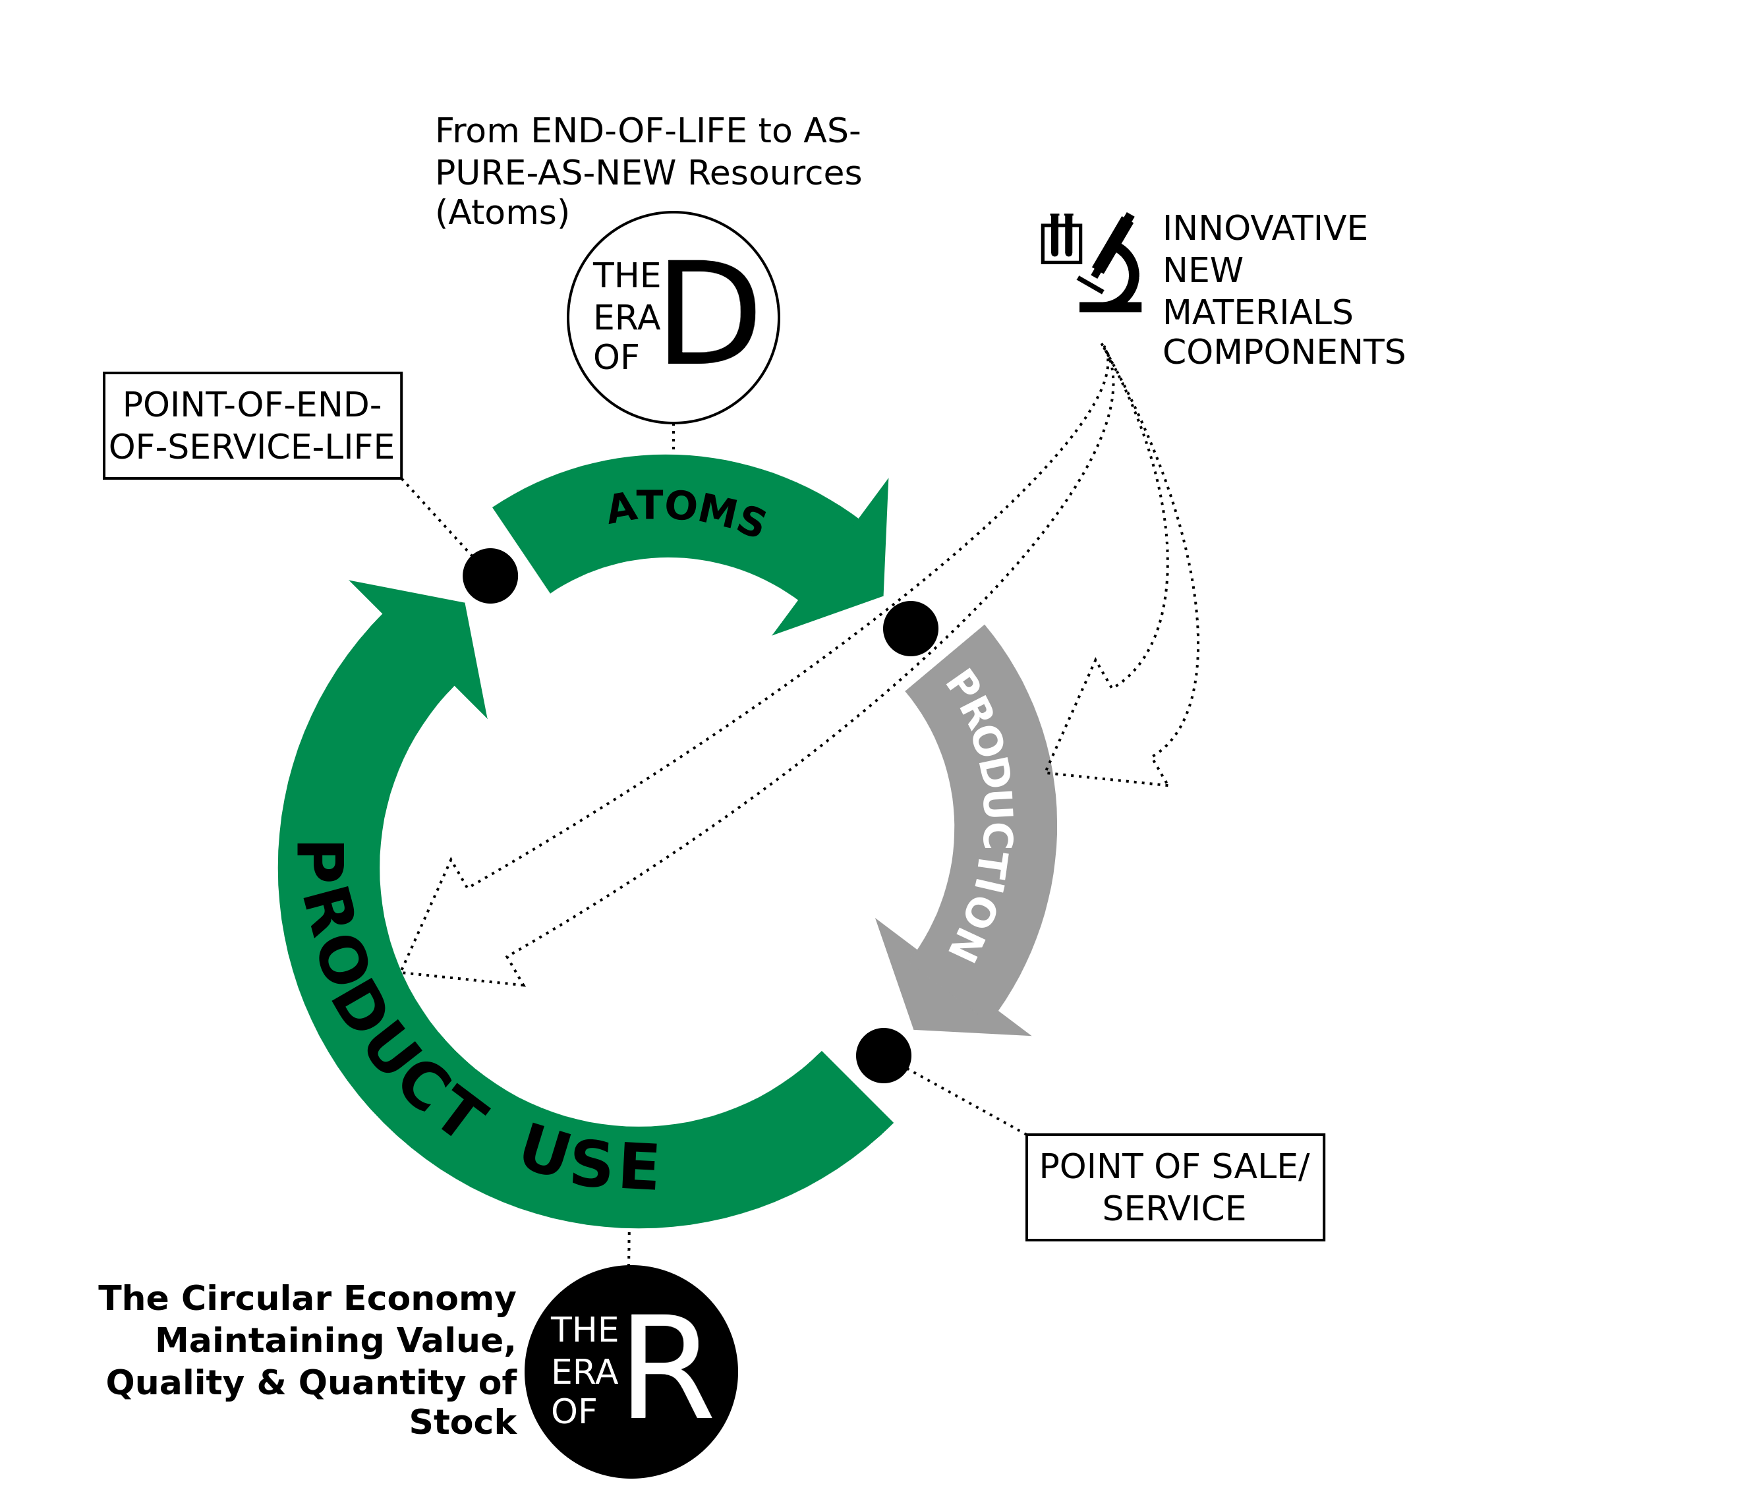
The Era of R
Techno-commercial strategies to keep goods and components at highest value level through:
Reuse
Repair
Remarket
Remanufacture
Re-refine
Reprogramme goods
Image adapted from Walter R. Stahel (2019) – The Circular Economy: A User’s Guide.

Slide 19
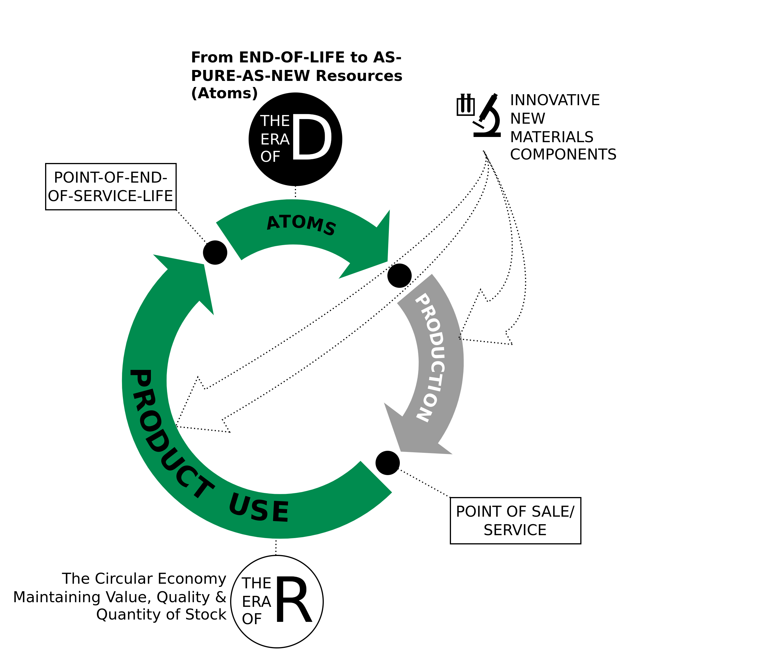
The Era of D
Technologies and actions to recover atoms and molecules at highest quality (purity and value) level as pure as virgin:
De-polymerise
De-alloy
De-laminate
De-vulcanise
De-coat materials
De-construct high-rise buildings and major infrastructure
Image adapted from Walter R. Stahel (2019) – The Circular Economy: A User’s Guide.

Slide 20
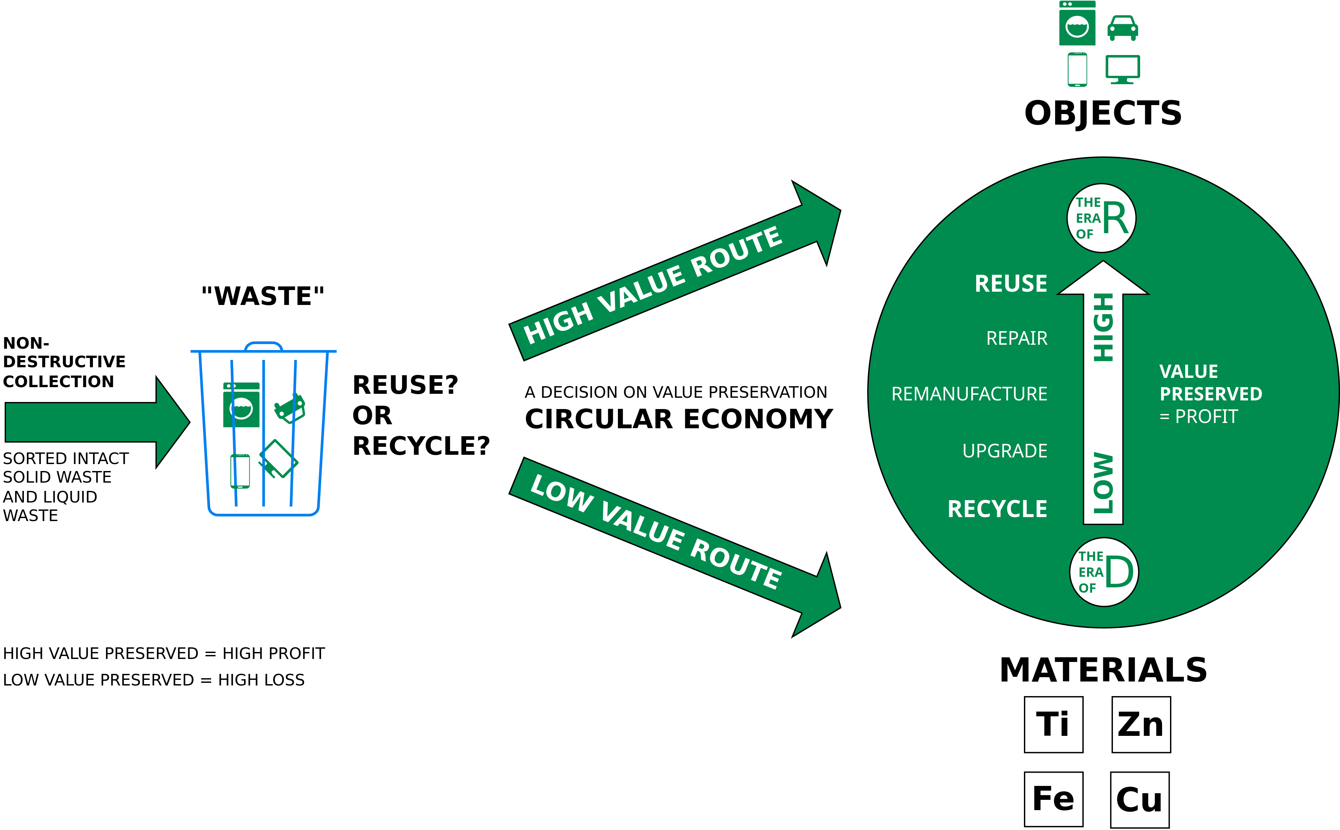
End-of-service-life business opportunities for value preservation: Reuse or Recycle?
Image adapted from Walter R. Stahel (2019) – The Circular Economy: A User’s Guide.

Slide 21
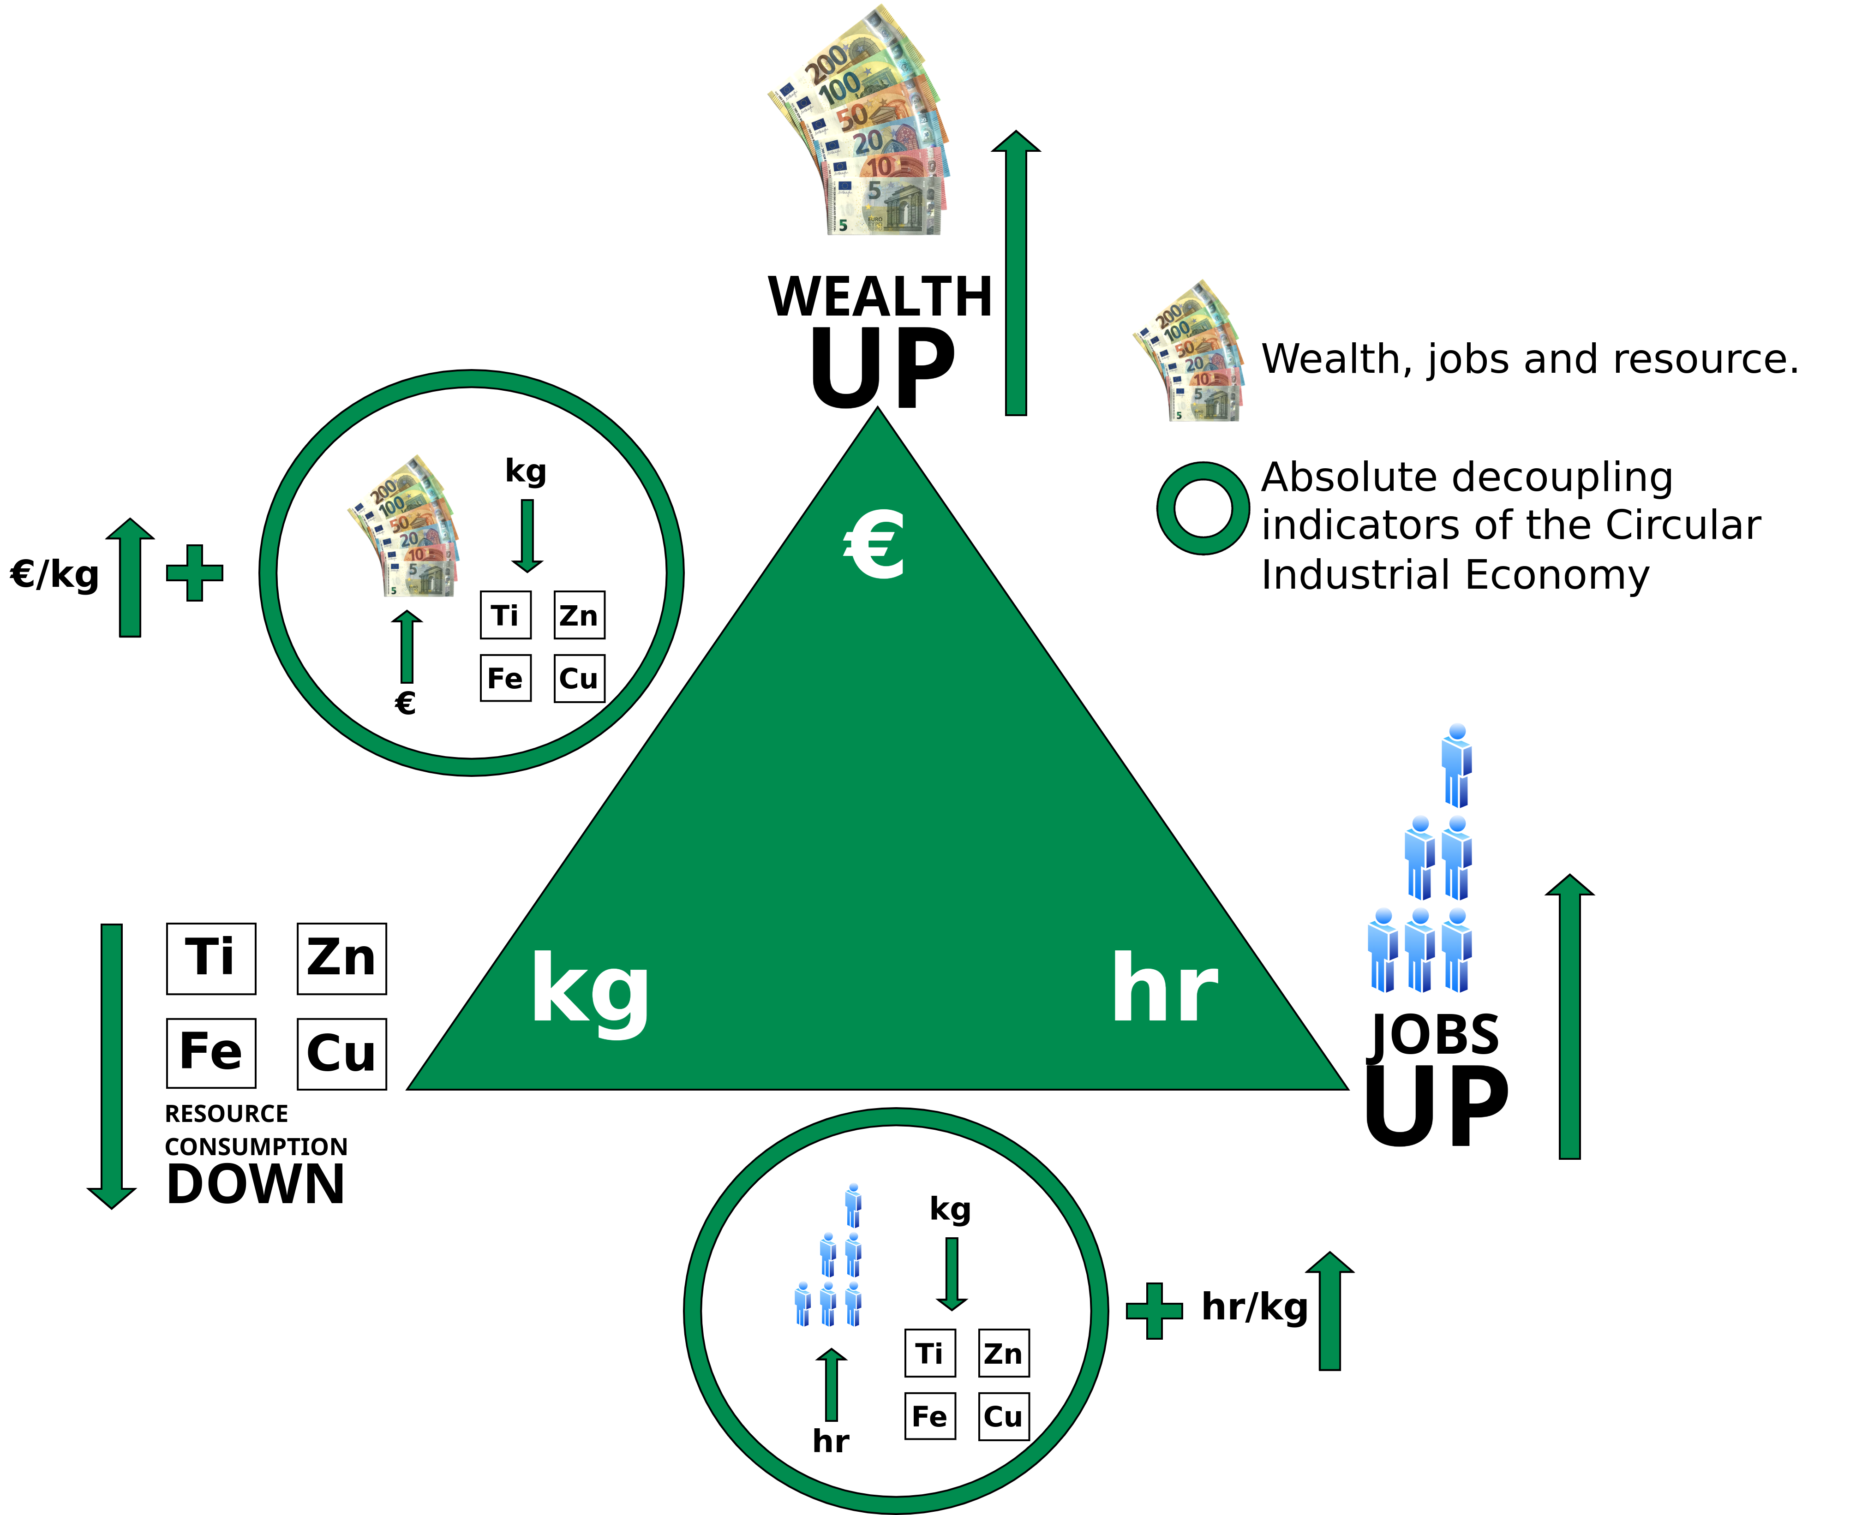
The two absolute decoupling indicators of the CIE monitoring more wealth and jobs from less resource consumption
Linear Economy: Low hr/kg (labor input per weight) ratios, coherent with mass production in highly mechanized processes, and low to medium €/kg (value per weight) ratios, in a range from basic materials like cement to smart goods like USB memory sticks
Circular Economy: Higher hr/kg and €/kg ratios for reuse, remanufacture and selling performance (goods as a service), in a group with new technologies, such as life sciences and nanotechnologies, which by nature produce dematerialized objects.
Image adapted from Walter R. Stahel (2019) – The Circular Economy: A User’s Guide.

Slide 22
The two absolute decoupling indicators of the CIE monitoring more wealth and jobs from less resource consumption
Linear Economy: Low hr/kg (labor input per weight) ratios, coherent with mass production in highly mechanized processes, and low to medium €/kg (value per weight) ratios, in a range from basic materials like cement to smart goods like USB memory sticks
Circular Economy: Higher hr/kg and €/kg ratios for reuse, remanufacture and selling performance (goods as a service), in a group with new technologies, such as life sciences and nanotechnologies, which by nature produce dematerialized objects.
Image adapted from Walter R. Stahel (2019) – The Circular Economy: A User’s Guide.

Slide 23
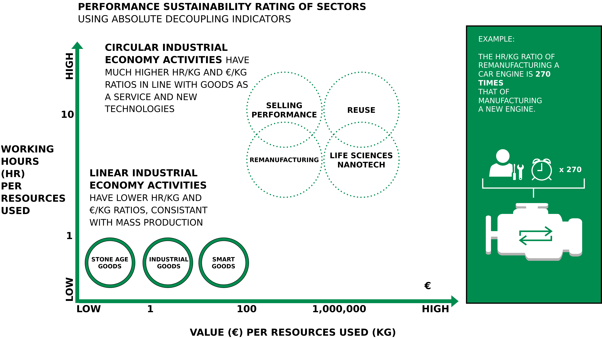
Absolute decoupling indicators make the difference between the LIE and the CIE visible
Image adapted from Walter R. Stahel (2019) – The Circular Economy: A User’s Guide.

Slide 24
Performance Economy

Slide 25

Performance Economy
Image adapted from Walter R. Stahel (2019) – The Circular Economy: A User’s Guide.

Slide 26
Performance Economy – Definition
„The Performance Economy sells results instead of objects. Its economic actors may be manufacturers of durable objects or fleet managers operating them. In both cases, they sell the use of these objects as a service over the longest possible period of time and maximize their profits by exploiting both efficiency and sufficiency solutions. “
Walter R. Stahel (2019) – The Circular Economy: A User’s Guide.

Slide 27
Performance Economy – Most sustainable CE business model?
Stahel argues:
“The Performance Economy of selling goods and molecules as a service, function guarantees or results and performance, is the most sustainable business model of the circular industrial economy because by internalising the costs of product liability, of risk and waste, it offers manufacturers a strong financial incentive to prevent losses and waste.”
Walter R. Stahel (2019) – The Circular Economy: A User’s Guide.

Slide 28
Performance Economy – Most sustainable CE business model?
Stahel argues:
“The Performance Economy of selling goods and molecules as a service, function guarantees or results and performance, is the most sustainable business model of the circular industrial economy because by internalising the costs of product liability, of risk and waste, it offers manufacturers a strong financial incentive to prevent losses and waste.”
“It maximises the profit potential by exploiting sufficiency, efficiency and systems solutions.”
Walter R. Stahel (2019) – The Circular Economy: A User’s Guide.

Slide 29
Performance Economy – Most sustainable CE business model?
Stahel argues:
“The Performance Economy of selling goods and molecules as a service, function guarantees or results and performance, is the most sustainable business model of the circular industrial economy because by internalising the costs of product liability, of risk and waste, it offers manufacturers a strong financial incentive to prevent losses and waste.”
“It maximises the profit potential by exploiting sufficiency, efficiency and systems solutions.”
“In addition, by maintaining the ownership of objects and embodied resources, it creates long-term corporate and national resource security at low cost.”
Walter R. Stahel (2019) – The Circular Economy: A User’s Guide.

Slide 30
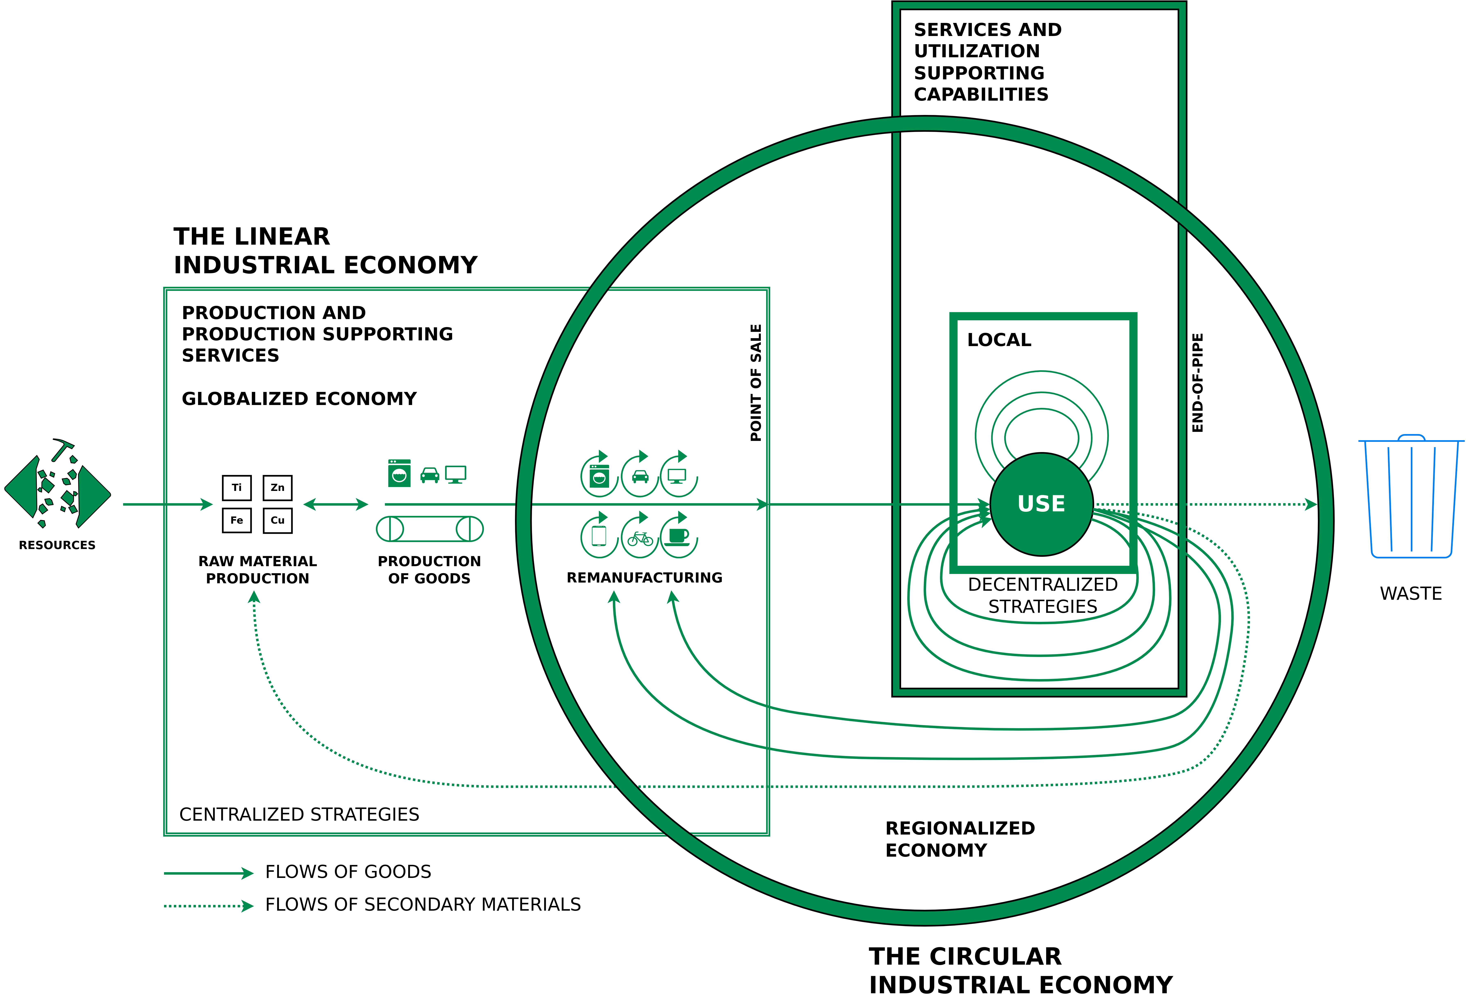
Situating the LIE, the CIE and the PE
Circle: Managing the utilisation or use phase of stocks of manufactured objects and their components, by maintaining the value and quality of infrastructure, buildings, investment goods, equipment and durable consumer goods in a local or regional economy
Small square: Local use-focused PE
Big square: Flows of used materials returning to the raw material producer to recover molecules and atoms in a globalised economy
Walter R. Stahel (2019) – The Circular Economy: A User’s Guide.

Slide 31
Situating the LIE, the CIE and the PE
Circle: Managing the utilisation or use phase of stocks of manufactured objects and their components, by maintaining the value and quality of infrastructure, buildings, investment goods, equipment and durable consumer goods in a local or regional economy
Small square: Local use-focused PE
Big square: Flows of used materials returning to the raw material producer to recover molecules and atoms in a globalised economy
Walter R. Stahel (2019) – The Circular Economy: A User’s Guide.

Slide 32
Situating the LIE, the CIE and the PE
Circle: Managing the utilisation or use phase of stocks of manufactured objects and their components, by maintaining the value and quality of infrastructure, buildings, investment goods, equipment and durable consumer goods in a local or regional economy
Small square: Local use-focused PE
Big square: Flows of used materials returning to the raw material producer to recover molecules and atoms in a globalised economy
Walter R. Stahel (2019) – The Circular Economy: A User’s Guide.

Slide 33
Example 1 – Foodsharing

Slide 34
The Problem
Food Waste – Overview (2015)
1.3 billion tons of the world's food ends up in the trash every year.
In Germany alone, 12 million tons of food are wasted every year → per capita: 75kg/year
Private households → 6.7 million tons (52%)
Processing → 2.2 million tons (18%)
Out-of-home-consumption → 1.7 million tons (14%)
Primary production → 1.4 million tons (12%)
Retail → 0.5 million tons (4%)
1.) BMEL (2021) – Lebensmittelabfälle in Deutschland: Aktelle Studie über Höhe der Lebensmittelabfälle nach Sektoren – https://www.bmel.de/DE/themen/ernaehrung/lebensmittelverschwendung/studie-lebensmittelabfaelle-deutschland.html
2.) Lebensmittelabfälle in Deutschland – Baseline 2015 (2019) – https://www.thuenen.de/media/publikationen/thuenen-report/Thuenen_Report_71.pdf

Slide 35
Question 1
What percentage of the food you purchase is ending up in your trash bin?
A: 0% – 10%
B: 10% – 25%
C: 25% – 40%
D: 40% – 50%

Slide 36
The Problem
Food Waste – Overview (2015)
1.3 billion tons of the world's food ends up in the trash every year.
In Germany alone, 12 million tons of food are wasted every year → per capita: 75kg/year
Private households → 6.7 million tons (52%)
Processing → 2.2 million tons (18%)
Out-of-home-consumption → 1.7 million tons (14%)
Primary production → 1.4 million tons (12%)
Retail → 0.5 million tons (4%)
1.) BMEL (2021) – Lebensmittelabfälle in Deutschland: Aktelle Studie über Höhe der Lebensmittelabfälle nach Sektoren – https://www.bmel.de/DE/themen/ernaehrung/lebensmittelverschwendung/studie-lebensmittelabfaelle-deutschland.html
2.) Lebensmittelabfälle in Deutschland – Baseline 2015 (2019) – https://www.thuenen.de/media/publikationen/thuenen-report/Thuenen_Report_71.pdf

Slide 37
The Problem
Food Waste – Overview (2015)
1.3 billion tons of the world's food ends up in the trash every year.
In Germany alone, 12 million tons of food are wasted every year → per capita: 75kg/year
Private households → 6.7 million tons (52%)
Processing → 2.2 million tons (18%)
Out-of-home-consumption → 1.7 million tons (14%)
Primary production → 1.4 million tons (12%)
Retail → 0.5 million tons (4%)
1.) BMEL (2021) – Lebensmittelabfälle in Deutschland: Aktelle Studie über Höhe der Lebensmittelabfälle nach Sektoren – https://www.bmel.de/DE/themen/ernaehrung/lebensmittelverschwendung/studie-lebensmittelabfaelle-deutschland.html
2.) Lebensmittelabfälle in Deutschland – Baseline 2015 (2019) – https://www.thuenen.de/media/publikationen/thuenen-report/Thuenen_Report_71.pdf

Slide 38
The Problem
Food Waste – Retail in more detail (2015)
Total food waste → 696,484 tons
Fruit and vegetables → 328,245 tons
Bread and baked goods → 206,399 tons
Dairy products → 60,255 tons
Meat-like/based products → 53,307 tons
Others → 48,279 tons
Where is the difference between the 0.5 million tons on the previous slide and the 696,484 tons on this slide coming from? → donated food (Tafel Deutschland e.V.)
1.) BMEL (2021) – Lebensmittelabfälle in Deutschland: Aktelle Studie über Höhe der Lebensmittelabfälle nach Sektoren – https://www.bmel.de/DE/themen/ernaehrung/lebensmittelverschwendung/studie-lebensmittelabfaelle-deutschland.html
2.) Lebensmittelabfälle in Deutschland – Baseline 2015 (2019) – https://www.thuenen.de/media/publikationen/thuenen-report/Thuenen_Report_71.pdf

Slide 39
The Problem
Food Waste – Retail in more detail (2015)
Total food waste → 696,484 tons
Fruit and vegetables → 328,245 tons
Bread and baked goods → 206,399 tons
Dairy products → 60,255 tons
Meat-like/based products → 53,307 tons
Others → 48,279 tons
Where is the difference between the 0.5 million tons on the previous slide and the 696,484 tons on this slide coming from? → donated food (Tafel Deutschland e.V.)
1.) BMEL (2021) – Lebensmittelabfälle in Deutschland: Aktelle Studie über Höhe der Lebensmittelabfälle nach Sektoren – https://www.bmel.de/DE/themen/ernaehrung/lebensmittelverschwendung/studie-lebensmittelabfaelle-deutschland.html
2.) Lebensmittelabfälle in Deutschland – Baseline 2015 (2019) – https://www.thuenen.de/media/publikationen/thuenen-report/Thuenen_Report_71.pdf

Slide 40
The Problem
Food Waste – Retail in more detail (2015)
Total food waste → 696,484 tons
Fruit and vegetables → 328,245 tons
Bread and baked goods → 206,399 tons
Dairy products → 60,255 tons
Meat-like/based products → 53,307 tons
Others → 48,279 tons
Where is the difference between the 0.5 million tons on the previous slide and the 696,484 tons on this slide coming from? → donated food (Tafel Deutschland e.V.)
1.) BMEL (2021) – Lebensmittelabfälle in Deutschland: Aktelle Studie über Höhe der Lebensmittelabfälle nach Sektoren – https://www.bmel.de/DE/themen/ernaehrung/lebensmittelverschwendung/studie-lebensmittelabfaelle-deutschland.html
2.) Lebensmittelabfälle in Deutschland – Baseline 2015 (2019) – https://www.thuenen.de/media/publikationen/thuenen-report/Thuenen_Report_71.pdf

Slide 41
Solution?
General
Make it illegal to throw food away → In February 2016, France adopted a law on fighting food waste that meant supermarkets were forbidden to destroy unsold food products and were compelled to donate it instead.
Has been later adopted in the gastronomy and related sectors

Slide 42
Alternative Solutions?
Foodsharing Platform
Click Me
Platform launched in 2012
Decentralized and self-organized
450,000 registered user (all volunteers)
Cooperates with more than 11,000 businesses
More than 65 million tons of food saved
https://foodsharing.de/

Slide 43
Alternative Solutions?
Foodsharing Platform – How does it work?
Register (free – no charges, no subscriptions)
Types of users:
1. User
Share your own leftovers or collect food from others (offers visible on the Foodsharing map)
2. Foodsavers
Pass a quiz (quite some effort) and become a Foodsaver.
Allowed to collect (“save”) leftovers from businesses that cooperate with Foodsharing
Redistribute saved food among friends and within the Foodsharing community
3. Operations manager (Betriebsverantwortlicher = abbr. “BV”)
Manage cooperation with business, manage your team of Foodsavers and organize a collection schedule
https://foodsharing.de/

Slide 44
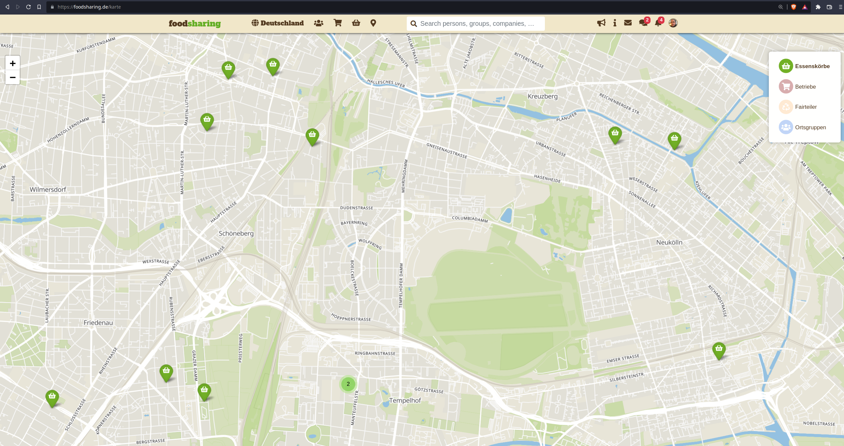
Alternative Solutions?
Foodsharing Platform – How does it work?
https://foodsharing.de/

Slide 45
Alternative Solutions?
Foodsharing Platform – How does it work?
Just keep/take what you can consume, redistribute everything else
Most businesses don’t want to be publicly mentioned
Bad image if you throw away huge amounts of food every day
People are supposed to buy their food at your place instead of picking it up for free ;)
Strict:
Food collection schedule (pre-defined time slots, each foodsaver only once every week or every two weeks, etc.)
Hygiene rules
Pre-defined procedures for collection of food
https://foodsharing.de/

Slide 46
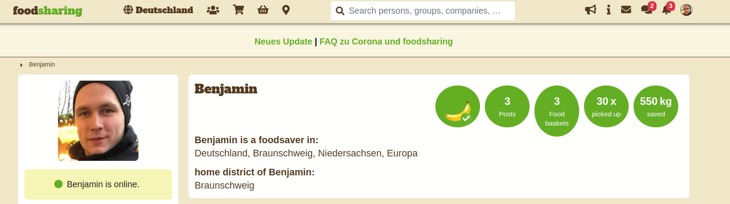
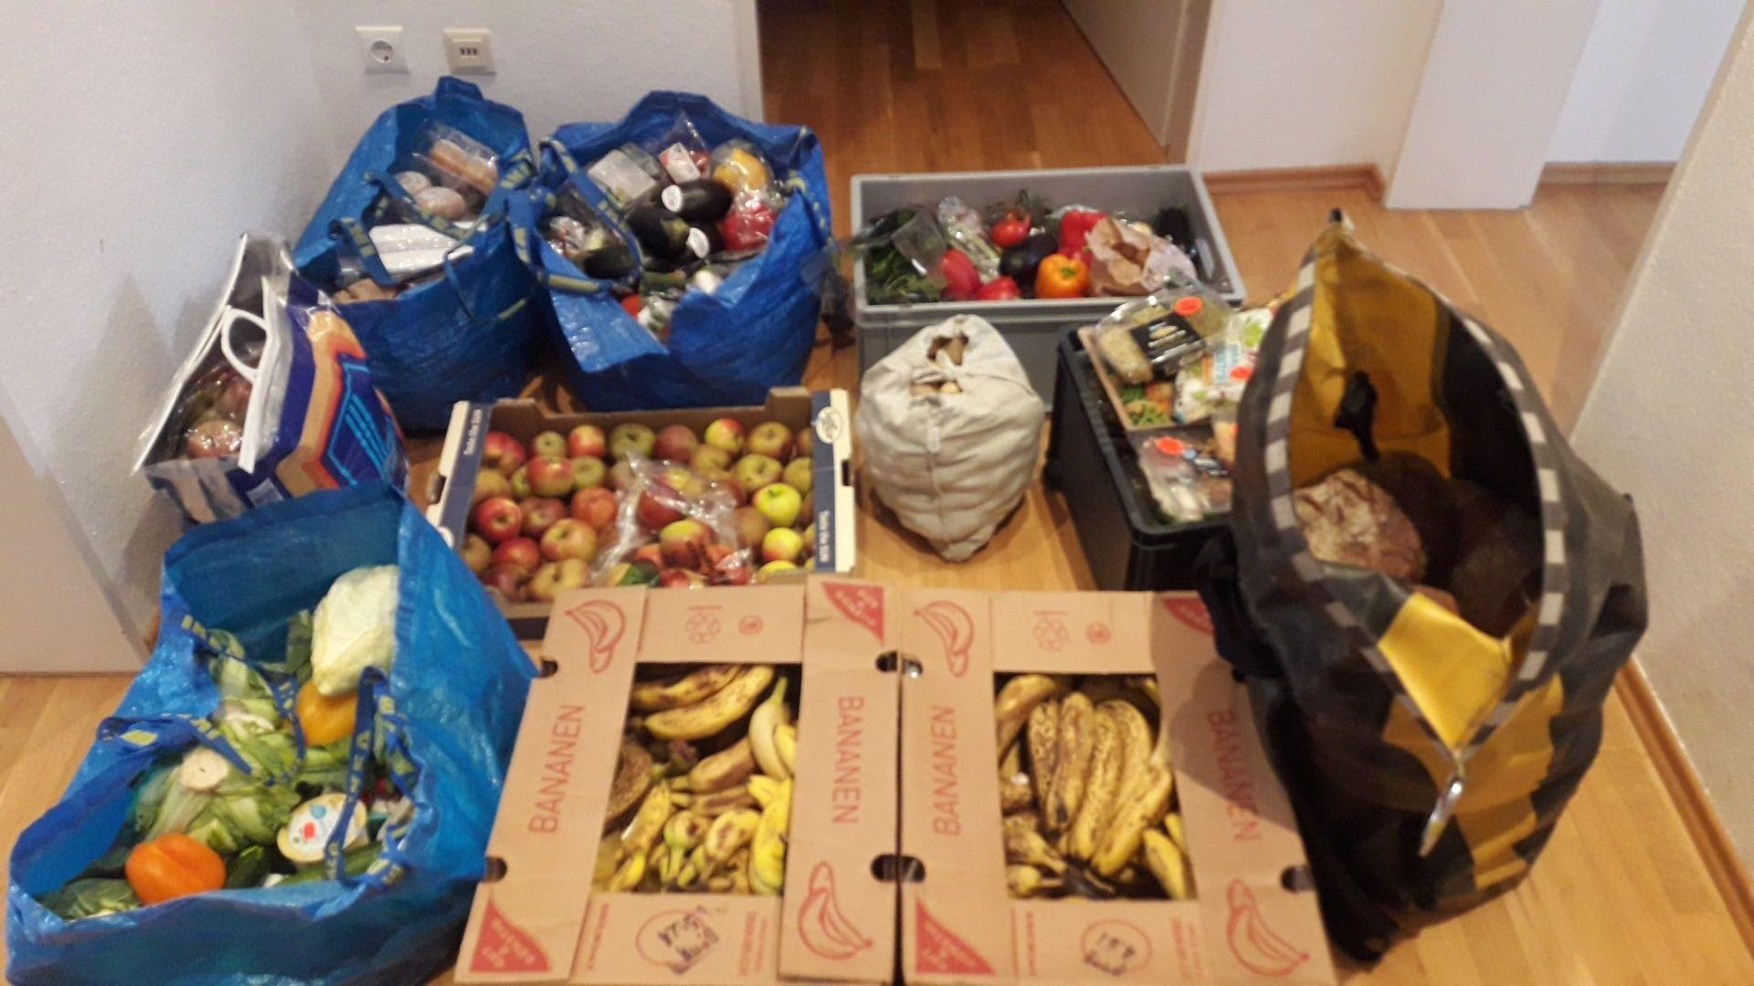
Alternative Solutions?
Foodsharing Platform – How much food is saved every day?
https://foodsharing.de/

Slide 47
Further Resources
Baccini et al. (2012) – Metabolism of the Anthroposphere: Analysis, Evaluation, Design
Meadows (1972) – The Limits to Growth
Meadows, Randers and Meadows (2004) – Limits to Growth – The 30-Year Update
Walter R. Stahel (2019) – The Circular Economy: A User's Guide
Website of the Ellen MacArthur Foundation – Link

Slide 48
Questions?

